Slide 1
Chapter 9
Files, Printing, and Structures

Slide 2
Topics
9.1 Using Files
9.2 The OpenFileDialog, SaveFileDialog, FontDialog, and ColorDialog Controls
9.3 The PrintDocument Control
9.4 Structures

Slide 3
Introduction
In this chapter you will learn how to:
Save data to sequential text files
Read data from the files back into the application
Use the OpenFileDialog, SaveFileDialog, ColorDialog, and FontDialog controls
For opening and saving files and for selecting colors and fonts with standard Windows dialog boxes
Use the PrintDocument control
To print reports from your application
Package units of data together into structures

Slide 4
Using Files
9.1

Slide 5
Data Can be Stored in a File
Thus far, all of our data has been stored in controls and variables existing in RAM
This data disappears once the program stops running
If data is stored in a file on a computer disk, it can be retrieved and used at a later time

Slide 6
The Process of Using a File
The following steps must be taken when a file is used by an application:
The file must be opened; If it does not yet exist, it must be created
Data is written to the file or read from the file
When the application is finished using the file, the file is closed

Slide 7
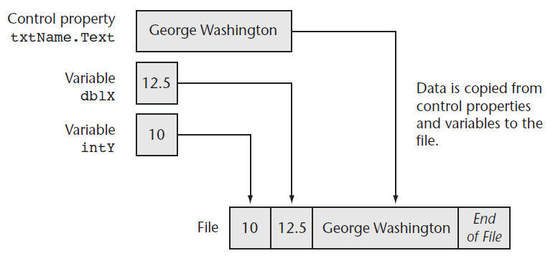
Output File
An output file is a file into which a program writes data

Slide 8
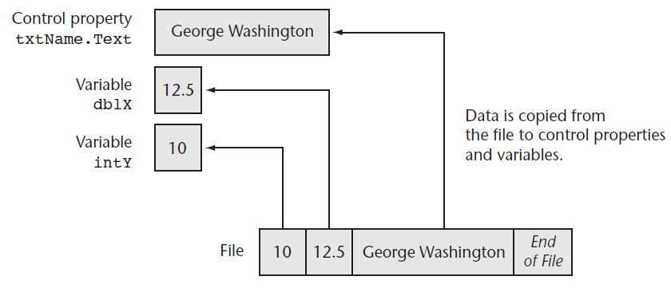
Input File
An input file is a file from which a program reads data

Slide 9
Sequential-Access File
The sequential-access file is the simplest type of data file
A sequential-access file is like a stream of data that must be read from beginning to end
Sometimes referred to as a text file
Can easily be created and modified using a text editor
Windows Notepad, for example

Slide 10
Writing to Files with StreamWriter Objects
Two basic ways to open a file for writing
Create a new file
Open an existing file and append data to it
A StreamWriter object performs the actual writing to the file
Two required steps:
Declare a StreamWriter variable
Call either File.CreateText or File.AppendText and assign its return value to the StreamWriter variable

Slide 11
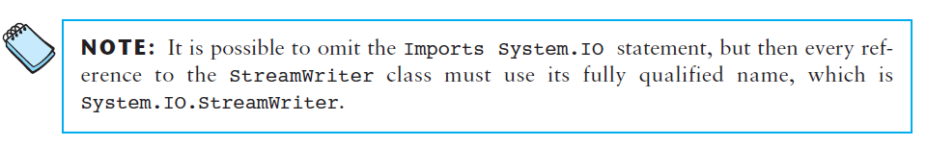
Using the Imports Statement for the StreamWriter Objects
To make the StreamWriter objects available to your program
Insert the following Imports statement at the top of your form’s code file:
Imports System.IO

Slide 12
Creating a Text File
Declare a StreamWriter variable using the following general format:
ObjectVar is the name of the object variable
You may use Private or Public in place of Dim
At the class-level or module-level
Here’s an example:
Dim ObjectVar As StreamWriter
Dim phoneFile As StreamWriter

Slide 13
Creating a Text File
Next, call the File.CreateText method, passing the name of a file
For example:
Notice the return value from File.CreateText is assigned to the StreamWriter variable named phoneFile
phoneFile = File.CreateText("phonelist.txt")

Slide 14
File Paths
The filename that you pass to the File.CreateText method
Can be a complete file path with drive letter
"C:\data\vbfiles\phonelist.txt"
Refer to a file in the default drive root directory
"\phonelist.txt"
Include no path information at all
"phonelist.txt"
If no path information specified
The \bin\Debug folder of the current project is used

Slide 15
Opening an Existing File and Appending Data to It
If a text file already exists, you may want to add more data to the end of the file
This is called appending the file
First, declare a StreamWriter variable
Then call the File.AppendText method, passing the name of an existing file
If the file does not exit it will be created
For example:
phoneFile = File.AppendText("phonelist.txt")

Slide 16
Writing Data to a File
The WriteLine method of the StreamWriter class writes a line of data to a file using the following general format:
ObjectVar is the name of the StreamWriter object variable
Data represents constants or variables whose contents will be written to the file
Calling the method without the Data argument writes a blank line to the file
The WriteLine method writes the data to the file and then writes a newline character immediately after the data
A newline character is an invisible character that separates text by breaking it into another line when displayed on the screen
ObjectVar.WriteLine(Data)

Slide 17
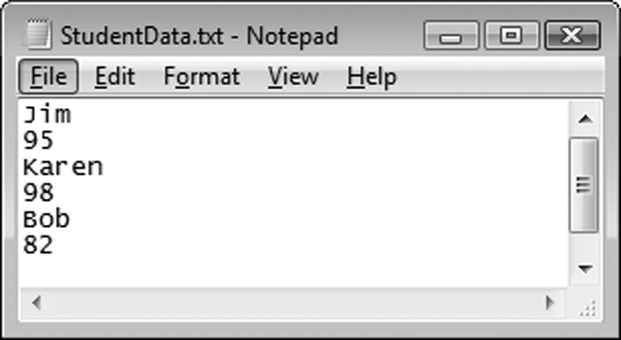
Writing Data to a File
The following writes three students’ first names and scores to a file:
In addition to separating the contents of a file into lines, the newline character also serves as a delimiter
A delimiter is an item that separates other items
Data must be separated in order for it to be read from a file
' Write data to the file.
studentFile.WriteLine("Jim")
studentFile.WriteLine(95)
studentFile.WriteLine("Karen")
studentFile.WriteLine(98)
studentFile.WriteLine("Bob")
studentFile.WriteLine(82)

Slide 18
The Write Method
The Write method is a member of the StreamWriter class that writes an item of data without writing a newline character using the following general format:
ObjectVar is the name of a StreamWriter object
Data represents the contents of a constant or variable that is written to the file
Writes data to a file without terminating the line with a newline character
A blank space or comma could be used to provide a delimiter between data items
ObjectVar.Write(Data)

Slide 19
Closing a File
The StreamWriter class has a method named Close that closes a file using the following general format:
ObjectVar is the StreamWriter object variable you want to close
The following statement closes a StreamWriter object variable named salesFile:
The Close method
Writes any unsaved information remaining in the file buffer
Releases memory allocated by the StreamWriter object
Tutorial 9-1 examines an application that writes data to a file
ObjectVar.Close()
salesFile.Close()

Slide 20
Appending Data to a File
When we append a file
We write new data immediately following existing data in the file
If an existing file is opened with the AppendText method
Data written to the file is appended to the file’s existing data
If the file does not exist, it is created

Slide 21
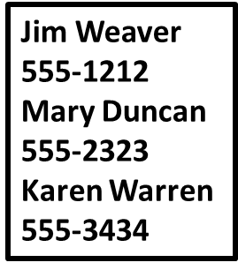
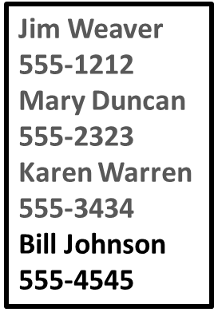
Appending Data to a File Example
The following example:
Opens a file in append mode and writes additional data to the file
' Declare an object variable
Dim friendFile As StreamWriter
' Open the file.
friendFile = File.AppendText("MyFriends.txt")
' Write the data.
friendFile.WriteLine("Bill Johnson")
friendFile.WriteLine("555–4545")
' Close the file.
friendFile.Close()
Before
After

Slide 22
Reading Files with StreamReader Objects
A StreamReader object reads data from a sequential text file
A StreamReader object is an instance of the StreamReader class
The StreamReader class provides methods for reading data from a file
Create a StreamReader object variable using the following general format:
ObjectVar is the name of the object variable
You may use Private or Public in place of Dim
At the class-level or module-level
Dim ObjectVar As StreamReader

Slide 23
Reading Files with StreamReader Objects
The File.OpenText method opens a file and stores the address of the StreamReader object variable using the following general format:
Filename is a string or a string variable specifying the path and/or name of the file to open
For example:
To make the StreamReader class available
Write the following Imports statement at the top of your code file:
File.OpenText(Filename)
Dim customerFile As StreamReader
customerFile = File.OpenText("customers.txt")
Imports System.IO

Slide 24
Reading Data from a File
The ReadLine method in the StreamReader class reads a line of data from a file using the following general format:
ObjectVar is the name of a StreamReader object variable
The method reads a line from the file associated with ObjectVar and returns the data as a string
For example, the following statement reads a line from the file and stores it in the variable:
ObjectVar.ReadLine()
strCustomerName = customerFile.ReadLine()

Slide 25
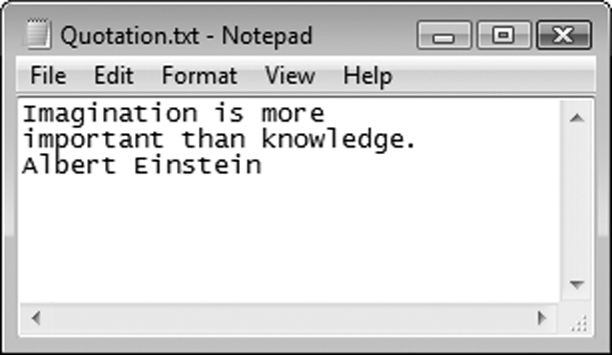


Reading Data from a File
Dim textFile As StreamReader
textFile = File.OpenText
("Quotation.txt")
Data is read from a file in a forward-only direction
When the file is opened:
Its read position is set to the first item in the file
As data is read:
The read position advances through the file
strInput = textFile.ReadLine()

Slide 26
Closing the File
The StreamReader class has a method named Close that closes an open StreamReader object using the following general format:
ObjectVar is the StreamReader object variable you want to close
The following statement closes a StreamReader object variable named readFile:
In Tutorial 9-2, you complete an application that uses the ReadLine statement
ObjectVar.Close()
readFile.Close()

Slide 27
Determining Whether a File Exists
To determine if a file exists before opening it, you can call the File.Exists method using the following general format:
Filename is the name of a file, which may include the path
The method returns True if the files exists or False if the file does not exist
File.Exists(Filename)
If File.Exists(strFilename) Then
' Open the file.
inputFile = File.OpenText(strFilename)
Else
MessageBox.Show(strFilename & " does not exist.")
End If

Slide 28
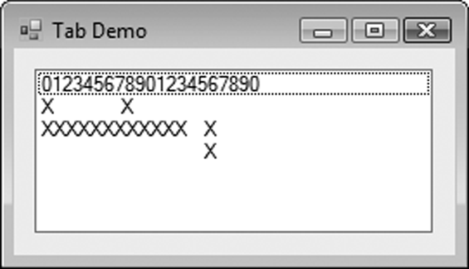
Using vbTab to Align Display Items
The predefined vbTab constant
Moves the print position forward to the next even multiple of 8
Can be used to align columns in displayed or printed output
ListBox1.Items.Add("012345678901234567890")
ListBox1.Items.Add("X" & vbTab & "X")
ListBox1.Items.Add("XXXXXXXXXXXX" & vbTab & "X")
ListBox1.Items.Add(vbTab & vbTab & "X")

Slide 29
Detecting the End of a File
In many cases, the amount of data in a file is unknown
Use the StreamReader object’s EndOfStream property to determine when the end of the file has been reached
If the end of the file has been reached, the property will be set to True
Otherwise, It will be set to False
The following example uses a Do Until loop that uses the EndOfStream property to determine the end of the file:
Tutorial 9-3 examines an application that detects the end of a file
Dim scoresFile As StreamReader
Dim strInput As String
scoresFile =
File.OpenText("Scores.txt")
Do Until scoresFile.EndOfStream
strInput = scoresFile.ReadLine()
lstResults.Items.Add(strInput)
Loop
scoresFile.Close()

Slide 30
Other StreamReader Methods
The Read method reads only the next character from a file and returns the integer code for the character using the following general format:
ObjectVar is the name of a StreamReader object
Use the Chr function to convert the integer code to a character
ObjectVar.Read
Dim textFile As StreamReader
Dim strInput As String = String.Empty
textFile = File.OpenText("names.txt")
Do While Not textFile.EndOfStream
strInput &= Chr(textFile.Read)
Loop
textFile.Close()

Slide 31
Other StreamReader Methods
The ReadToEnd method reads and returns the entire contents of a file beginning at the current read position using the following general format:
ObjectVar is the name of a StreamReader object
ObjectVar.ReadToEnd
Dim textFile As StreamReader
Dim strInput As String
textFile = File.OpenText("names.txt")
strInput = textFile.ReadToEnd()
textFile.Close()

Slide 32
Working with Arrays and Files
The contents of an array can easily be written to a file using a loop
Dim outputFile as StreamWriter
outputFile = File.CreateText("Values.txt")
For intCount = 0 To (intValues.Length – 1)
outputFile.WriteLine(intValues(intCount))
Next
outputFile.Close()

Slide 33
Working with Arrays and Files
And it is just as easy to read the contents of a file into an array using a loop
Dim inputFile as StreamReader
inputFile = File.OpenText("Values.txt")
For intCount = 0 To (intValues.Length – 1)
intValues(intCount) = CInt(inputFile.ReadLine())
Next
inputFile.Close()

Slide 34
The OpenFileDialog, SaveFileDialog, FontDialog, and ColorDialog Controls
9.2

Slide 35
The OpenFileDialog and SaveFileDialog Controls
Windows has a standard method of allowing a user to choose a file to open or save
These methods let users browse for a file
The OpenFileDialog control and SaveFileDialog control provide this capability in Visual Basic
To use the OpenFileDialog control
Double-click on the OpenFileDialog tool in the Toolbox window under the Dialogs tab
Appears in component tray
Use ofd as standard prefix when naming
SaveFileDialog is used in a similar way

Slide 36
Displaying an Open Dialog Box
Display control with the ShowDialog method
Method returns a value indicating which dialog box button the user selects:
Windows.Forms.DialogResult.OK for the OK button
Windows.Forms.DialogResult.Cancel for the Cancel button
For example:
ControlName.ShowDialog()
If ofdOpenFile.ShowDialog() = Windows.Forms.DialogResult.OK Then
MessageBox.Show(ofdOpenFile.FileName)
Else
MessageBox.Show("You selected no file.")
End If

Slide 37
The Filter Property
FileDialog controls have a Filter property
Limits files shown to specific file extensions
Specify filter description shown to user first
Then specify the filter itself
Pipe symbol (|) used as a delimiter
Filter property lets user choose:
Text files (*.txt), displays all .txt files
All files (*.*), displays all file extensions

Slide 38
Other OpenFileDialog Properties
The InitialDirectory property is the initially displayed folder
The Title property specifies the text on the title bar
The following example sets the Filter, InitialDirectory and Title properties:
' Configure the Open dialog box and display it.
With ofdOpenFile
.Filter = "Text files (*.txt)|*.txt|All files (*.*)|*.*"
.InitialDirectory = "C:\Data"
.Title = "Select a File to Open"
If.ShowDialog() = Windows.Forms.DialogResult.OK Then
inputFile = File.OpenText(.Filename)
End If
End With

Slide 39
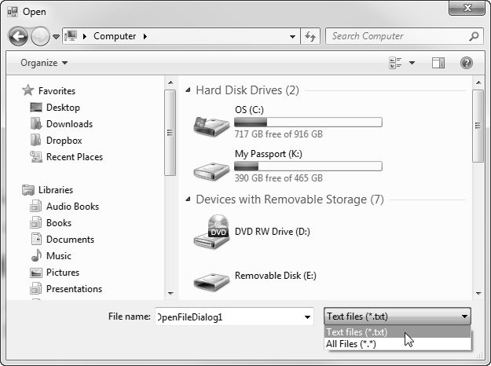
Open Dialog Box Example

Slide 40
The SaveFileDialog Control
The SaveFileDialog uses the same methods:
ShowDialog
The same properties:
Filter
InitialDirectory
Title
And the same result constants:
Windows.Forms.DialogResult.OK
Windows.Forms.DialogResult.Cancel
Tutorial 9-4 uses these controls in a text editor

Slide 41
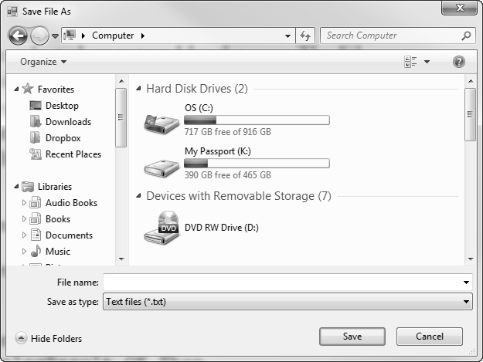
Windows Save As Dialog Box Example

Slide 42
The ColorDialog Control
The ColorDialog control displays a standard Windows Color Dialog box
To place a ColorDialog control on a form
Double-click the ColorDialog icon in the Dialogs section of the Toolbox window
Control appears in the component tray
Use the prefix cd when naming the control
To display a Color dialog box, call the ShowDialog method
Returns one of the following values
Windows.Forms.DialogResult.OK
Windows.Forms.DiallogResult.Cancel

Slide 43
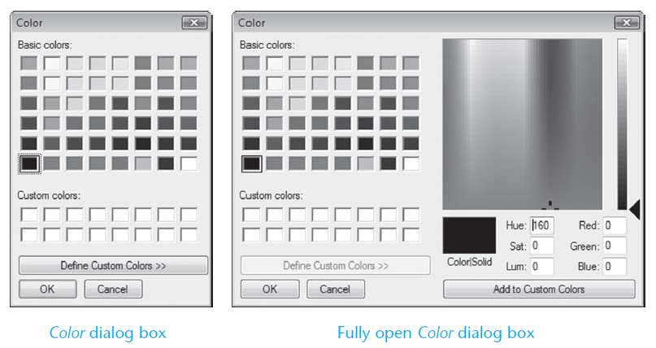
Windows Color Dialog Box Example

Slide 44
The FontDialog Control
The FontDialog control displays a standard Windows Font Dialog box
To place a FontDialog control on a form
Double-click the FontDialog icon in the Dialogs section of the Toolbox window
Control appears in the component tray
Use the prefix fd when naming the control
To display a Color dialog box, call the ShowDialog method
Returns one of the following values
Windows.Forms.DialogResult.OK
Windows.Forms.DiallogResult.Cancel

Slide 45
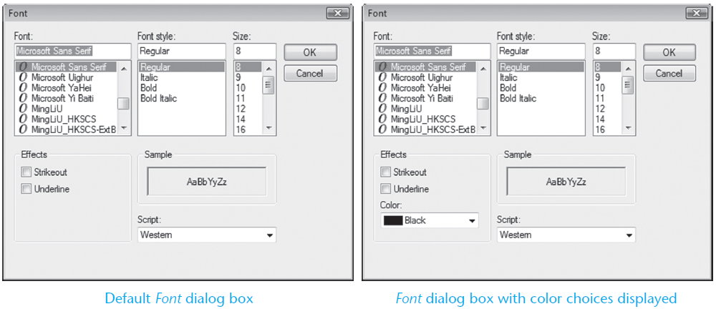
Windows Font Dialog Box Example

Slide 46
The PrintDocument Control
9.3

Slide 47
The PrintDocument Control
The PrintDocument control gives your application the ability to print output on the printer
To place a PrintDocument control on a form
Double-click the PrintDocument tool in the Printing section of the Toolbox
Appears in the component tray
Use the prefix pd when naming the control

Slide 48
The Print Method and the PrintPage Event
The PrintDocument control has a Print method that starts the printing process using the following general format:
When the method is called, it triggers a PrintPage event
You must write code in the event handler to initiate printing
To create a PrintPage event handler code template:
Double-click the PrintDocument control in the component tray
The event handler code template appears in the Code window:
PrintDocumentControl.Print()
Private Sub pdPrint_PrintPage(...) Handles pdPrint.PrintPage
End Sub

Slide 49
The Print Method and the PrintPage Event
Inside the PrintPage event hander
You write code that sends text to the printer
Using a specified
Font
Color
Location
With the e.Graphics.DrawString method

Slide 50
The Print Method and the PrintPage Event
The e.Graphics.DrawString method uses the following general format:
String is the string to be printed
FontName is a string holding the name of the font to use
Size is the size of the font in points
Style is the font style (bold, italic, regular, strikeout, or underline)
Brushes.Black specifies that the output should be printed in black
Hpos is the horizontal position of the output, in points, from the left margin
Vpos is the vertical position of the output, in points, from the top margin
In Tutorial 9-5, you will modify the Simple Text Editor application from Tutorial 9-4 by adding a Print command to the File menu
e.Graphics.DrawString(String, New Font(FontName,
Size, Style, Brushes.Black, HPos, VPos)

Slide 51
PrintPage Event Handler Example
Dim inputFile As StreamReader ' Object variable
Dim intX As Integer = 10 ' X coordinate for printing
Dim intY As Integer = 10 ' Y coordinate for printing
' Open the file.
inputFile = File.OpenText(strFilename)
' Read all the lines in the file.
Do While Not inputFile.EndOfStream
' Print a line from the file.
e.Graphics.DrawString(inputFile.ReadLine(),
New Font ("Courier", 10, FontStyle.Regular),
Brushes.Black, intX, intY)
' Add 12 to intY
intY += 12
Loop
' Close the file.
inputFile.Close()

Slide 52
Formatted Reports with String.Format
Reports typically contain the following sections:
A report header
Printed first, contains general information such as
The name of the report
The date and time the report was printed
The report body
Contains the report’s data
Often formatted in columns
An optional report footer
Contains the sum of one for more columns of data

Slide 53
Printing Reports with Columnar Data
Report data is typically printed in column format
With each column having an appropriate header
You can use Monospaced fonts to ensure that
Each character takes same amount of space
Columns will be aligned
String.Format method is used to align data along column boundaries

Slide 54
Using String.Format to Align Data along Column Boundaries
The String.Format method can be used to align data along column boundaries using the following general format:
FormatString is a string containing the formatting specifications
Arg0 and Arg1 are values to be formatted
The [,…] notation indicates that more arguments may follow
The method returns a string that contains the data
Provided by the arguments (Arg0, Arg1, etc)
Formatted with the specifications found in FormatString
String.Format(FormatString, Arg0, Arg1 [,...])

Slide 55

Arguments of the String.Format Method
Contains three sets of numbers inside curly braces
The first number in a set specifies the argument index number
0 represents the index for intX
1 represents the index for intY
2 represents the index for intZ
The second number in a set is an absolute value that specifies the column width, in spaces, and the type of justification that will be used
A positive number specifies right justification
A negative number specifies left justification

Slide 56
Example Report Header and Column Headings
Dim intCount As Integer ' Loop counter
Dim decTotal As Decimal = 0 ' Accumulator
Dim intVertPosition As Integer ' Vertical printing position
' Print the report header.
e.Graphics.DrawString("Sales Report",
New Font("Courier New", 12,FontStyle.Bold),
Brushes.Black, 150, 10)
e.Graphics.DrawString("Date and Time: " & Now.ToString(),
New Font("Courier New", 12, FontStyle.Bold),
Brushes.Black, 10, 38)
' Print the column headings.
e.Graphics.DrawString(String.Format("{0, 20} {1, 20}
","NAME", "SALES"),
New Font("Courier New", 12, FontStyle.Bold),
Brushes.Black, 10, 66)

Slide 57
Example Report Body and Footer
' Print the body of the report.
intVertPosition = 82
For intCount = 0 To 4
e.Graphics.DrawString(String.Format("{0, 20} {1, 20}",
strNames(intCount),decSales(intCount).ToString("c")),
New Font("Courier New", 12, FontStyle.Regular),
Brushes.Black, 10, intVertPosition)
decTotal += decSales(intCount)
intVertPosition += 14
Next
' Print the report footer.
e.Graphics.DrawString("Total Sales: " & decTotal.ToString("c"),
New Font("Courier New", 12, FontStyle.Bold),
Brushes.Black, 150, 165)

Slide 58
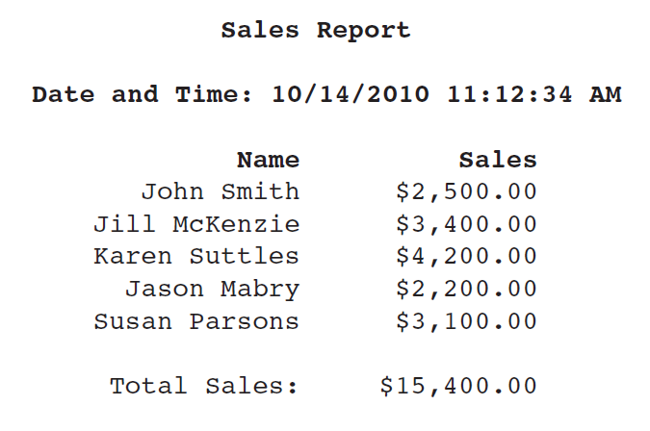
Example Report Output

Slide 59
Structures
9.4

Slide 60
Arrays versus Structures
Arrays:
Multiple fields in one array
All of the same data type
Distinguished by a numerical index
Structures
Multiple fields in one structure
Can be of differing data types
Distinguished by a field name

Slide 61
Creating a Structure
A structure is a data type you can create that contains one or more variables known as fields
You create a structure at the class or module-level with the structure statement:
For example:
[AccessSpecifier] Structure StructureName
FieldDeclarations
End Structure
Structure EmpPayData
Dim intEmpNumber As Integer
Dim strFirstName As String
Dim strLastName As String
Dim dblHours As Double
Dim decPayRate As Decimal
Dim decGrossPay As Decimal
End Structure

Slide 62
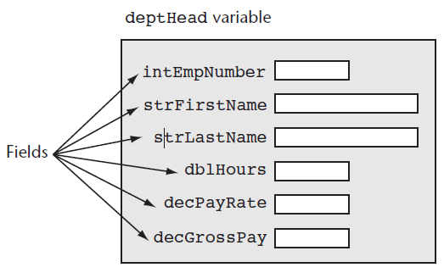
Declaring a Structure
Dim deptHead As EmpPayData
With deptHead
.intEmpNumber = 1101
.strFirstName = "Joanne"
.strLastName = "Smith"
.dblHours = 40.0
.decPayRate = 25
.decGrossPay = CDec(deptHead.dblHours) * deptHead.decPayRate
End With

Slide 63
Passing Structure Variables to Procedures and Functions
Structures can be passed to procedures and functions like any other variable
The data type to use in the specification is the name of the structure
Sub CalcPay(ByRef employee As EmpPayData)
' This procedure accepts an EmpPayData variable
' as its argument. The employee's gross pay
' is calculated and stored in the grossPay
' field.
With employee
.decGrossPay =.dblHours * .decPayRate
End With
End Sub

Slide 64
Arrays as Structure Members
Structures can contain arrays
Must ReDim after declaring structure variable
Structure StudentRecord
Dim strName As String
Dim dblTestScores() As Double
End Structure
Dim student As StudentRecord
ReDim student.dblTestScores(4)
student.strName = "Mary McBride"
student.dblTestScores(0) = 89.0
student.dblTestScores(1) = 92.0
student.dblTestScores(2) = 84.0
student.dblTestScores(3) = 96.0
student.dblTestScores(4) = 91.0

Slide 65
Arrays of Structures
You can declare an array of structures
employees is an array of type EmpPayData with 10 elements
To access individual elements in the array, use a subscript
Us the ReDim statement to set the size of each array field
Tutorial 9-6 examines an application that uses a structure
Const intMAX_SUBSCRIPT As Integer = 9
Dim employees(intMAX_SUBSCRIPT) As EmpPayData
employees(0).intEmpNumber = 1101
For intIndex = 0 To intMax_SUBSCRIPT
ReDim students(intIndex).dblTestScores(4)
Next

